Slide 1
Intel/TRIF Electrocoagualtion Project
Space Grant Mentor: Profs. James C. Baygents & James Farrell
Research Intern & Presenter: Jake Davis

Slide 2
Project Purpose & Motivation
Purpose: Assess electrocoagulation (EC) as a technology for municipal and industrial water purification.
  measure removal of: As, Si, Ca, Mg & dissolved organics
Motivation
EC can be used to remove a broad spectrum of contaminants and reduce TSS
EC can be inexpensive and straightforward to implement
Anions associated with chemical coagulants (e.g. Cl⁻ and SO₄²⁻) are avoided with EC—so, EC is salt-free and pH neutral

Slide 3
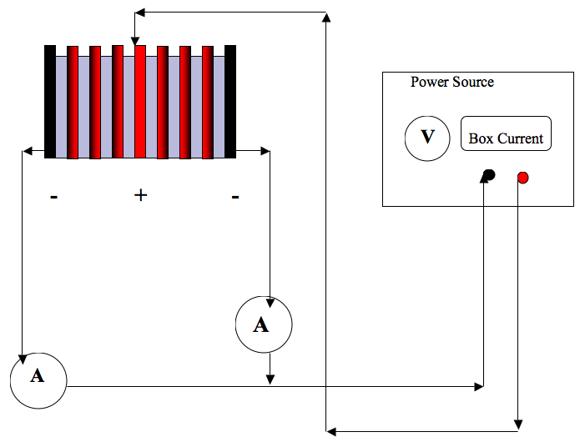
EC Flow Through Cell
Water Out
Water In

Slide 4
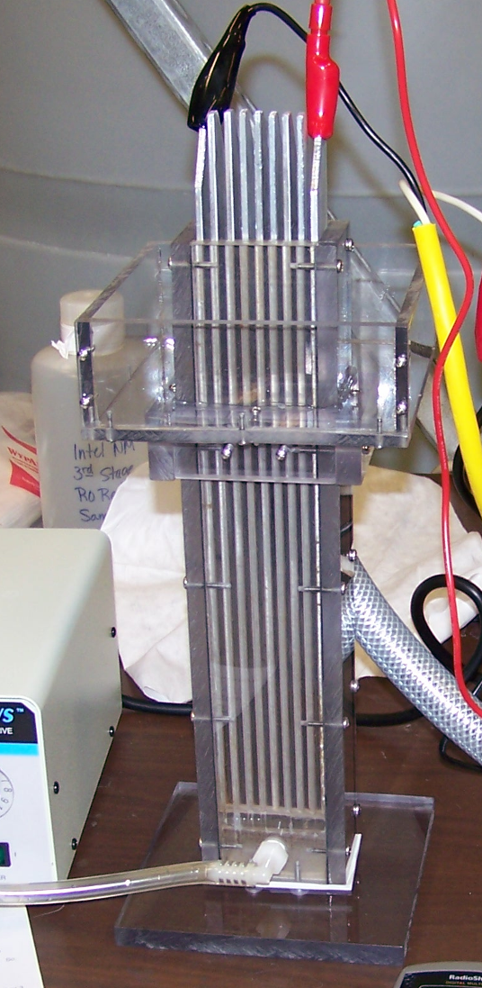
EC Flow Through Cell

Slide 5
Reaching Steady State: Al electrode
Faraday’s law

Slide 6
Reaching Steady State: Fe electrode
Faraday’s Law

Slide 7
Contaminant removal: Fe electrode
Feed Water: silica (50 ppm), calcium (45 ppm), and magnesium (12 ppm)

Slide 8
Contaminant removal: Fe electrode
Water Composition: arsenic (135 ppm), calcium (45 ppm), and magnesium (12 ppm)

Slide 9
Contaminant Removal: Fe electrode
Feed Water: arsenic (135 ppm), silica (50 ppm), calcium (45 ppm), and magnesium (12 ppm)

Slide 10
Summary
The time required for an EC unit to reach steady state is significant
Fe dissolution is approximated by Faraday’s law
Al dissolution is greater than Faraday’s law predicts
EC simply and effectively reduces the arsenic and silica content of municipal and industrial water
The removal of calcium and magnesium from water via EC is positively affected by the presence of arsenic

